Slide 1
Mantid Release Presentation
Release 3.0
ISIS

Slide 2
What is this meeting
Release 3.0
Release planned Monday 4th November
Present the changes and improvements
Focus on Python
What’s coming next

Slide 3


What we targeted for v3.0
ISIS
Live event data reduction
Automatic Reduction
Training courses
Introduction to Mantid
Introduction to Python
Python in Mantid
Extending Mantid using Python
Support for ICAT 4
Removal of Python API v1
Various technique led improvements

Slide 4
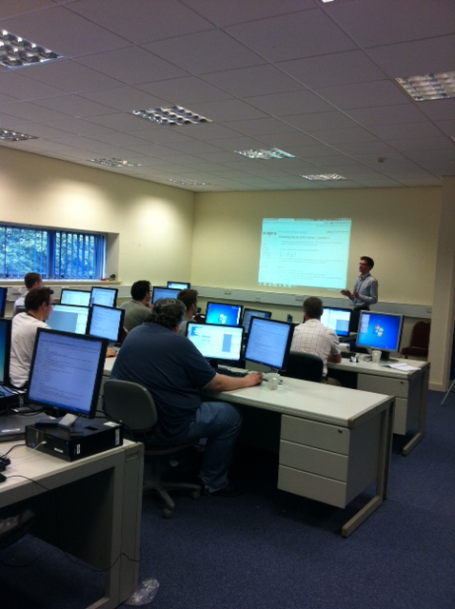
Training Courses
4 Courses
Introduction to Mantid
Introduction to Python
Python in Mantid
Extending Mantid using Python
Dates
9-11th September (Completed)
12-14th November (Full)
8-10th January (Spaces available)
14-17th January (ORNL) (Planned)
To Book
Email: nick.draper@stfc.ac.uk
More details at www.mantidproject.org

Slide 5
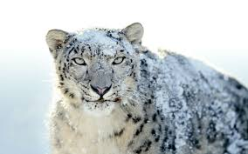

Supported Platforms
Staying the same
RHEL 6 64bit
Windows XP 32bit
Windows 7 64 bit
Ubuntu LTS 64 bit
Last supporting release
OSX Snow Leopard +
Future Releases
OSX Mountain Lion +

Slide 6
User Interface

Slide 7
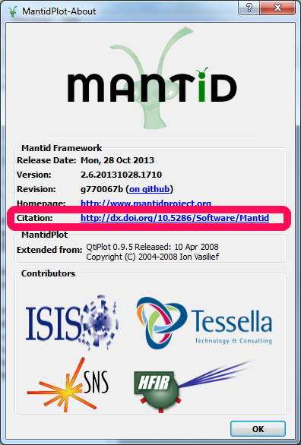
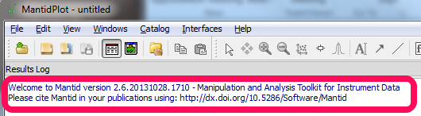
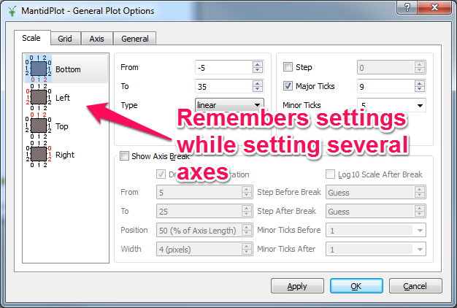
User Interface
Citing Mantid
Each Release is now assigned a new DOI
Easy to reference and search
General Plot Options

Slide 8
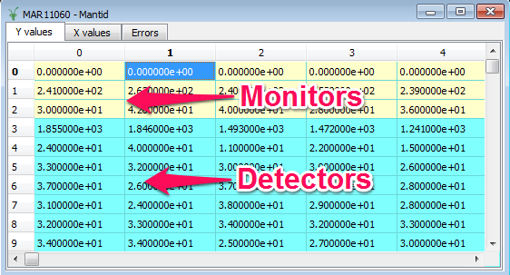
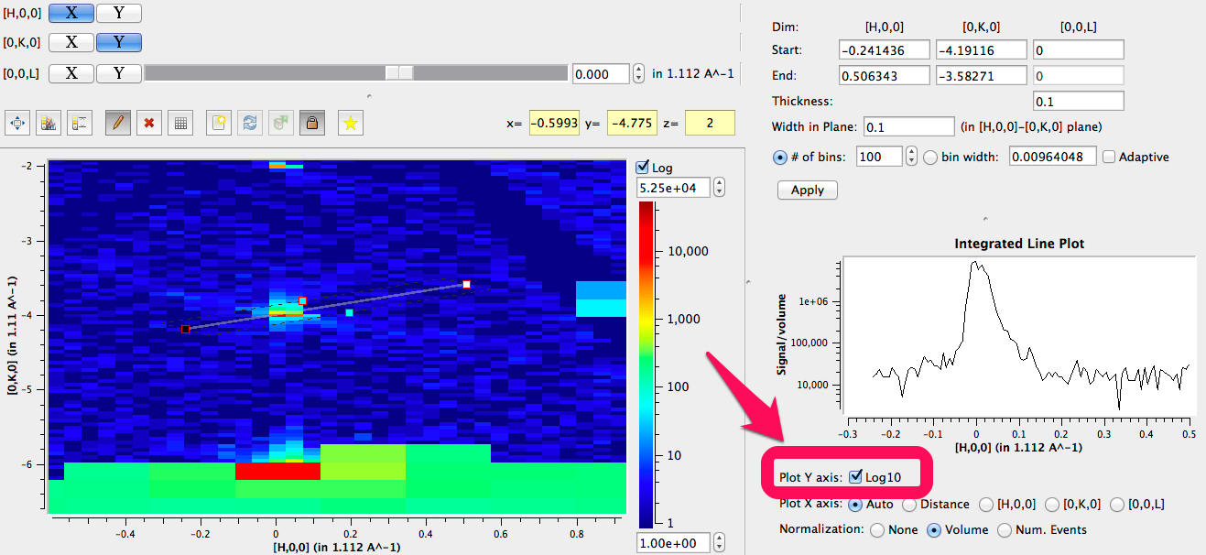
User Interface
Highlighting Monitors
LineViewer in SliceViewer
Log axes

Slide 9
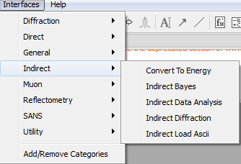
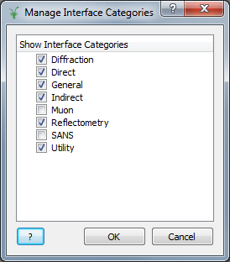
User Interface
Interfaces Menu
Sorted into Categories
Hide unwanted categories

Slide 10
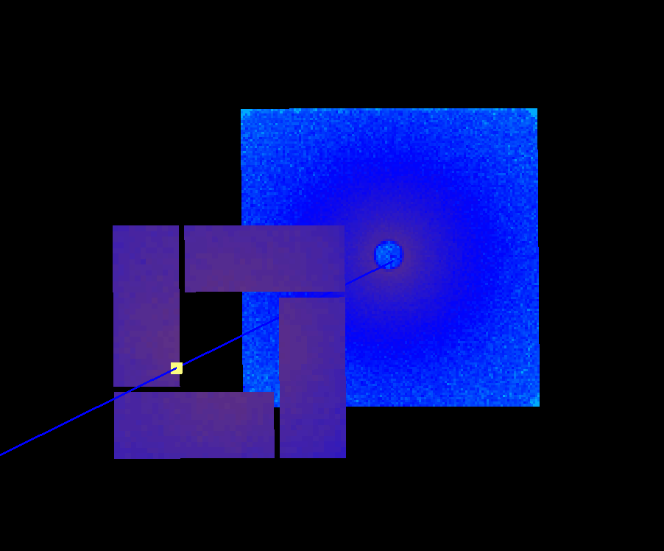
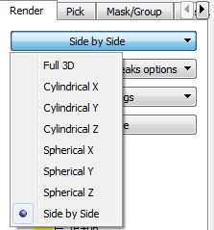

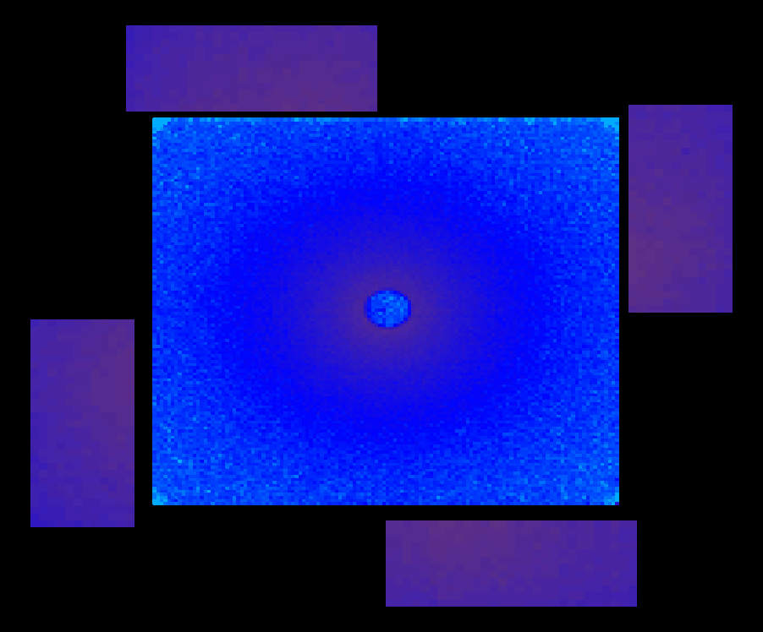
Side by Side Instrument View

Slide 11
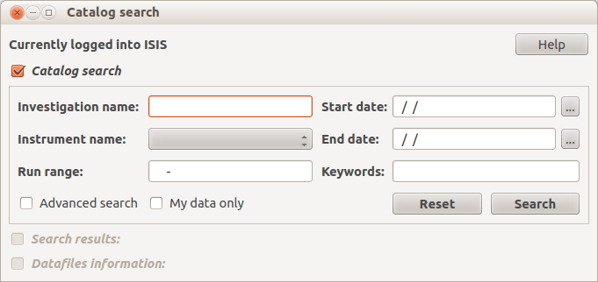
New ICAT interface
Combined functionality of all previous ICAT interfaces into one complete interface.
Notes:
For this release I have re-designed ICAT within Mantid. Previously, there was several different windows that achieved a collective goal. I have combined these into one minimal interface that allows you to perform searching/retrieval and downloading of datafiles for specific investigations, as we will see in a demo shortly.

Slide 12
New ICAT features
ICAT 4.3 support
Cross platform compatibility
load datafiles directly from archives
Download dialog window
External downloading
Several minor interface features, which will be illustrated in the DEMO.
Notes:
Within ICAT we now use ICAT 4.3 by default. This means searches that you perform, and results returned from them are much quicker, in fact, up to 10 times in places. This improves the responsiveness of ICAT within Mantid, and provides a “snappy” response.
Previously there was issues on OSX/Unix when downloading/loading datafiles with ICAT. This has been resolved, and ICAT within Mantid now functions accordingly on all supported platforms.
Previously downloaded files from ICAT would be saved in your default directory. Now when you select “download to…” a dialog window opens that asks you where to save the datafiles. This path is remembered for the future, and is then used by default. For example, if you save a datafile to the desktop, then want to save another datafile at some point later the
If you do not have access to the archives on your machine you can still download, and load datafiles using the ICAT interface. It’s slightly different in that the files will be downloaded over the Internet, then loading into Mantid.
As the interface was completely redesigned there are several minor interface features that making using the interface a joy, as we will see in the demo.

Slide 13
Framework

Slide 14
Framework
PSI
LoadSINQ
LoadFlexiNexus
McStas
LoadMcStas added (McStas 2.1 histogram and event data)
LoadMcStasNexus kept (McStas 2.0 histogram data)
Simulated
data
ISIS
data
Difference
data
-
=

Slide 15
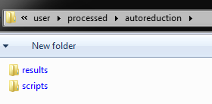
Framework
Auto reduction service
In ISIS network User folder (e.g. \\isis\inst$\NDXHRPD\user)
reduce.py

Slide 16
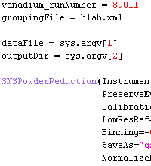
Framework
Example reduce.py :
Specify any custom setup
Grab input arguments
What to run

Slide 17
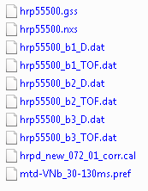
Framework
Auto reduction output
In addition: cataloguing
for next release

Slide 18
Framework
Summary:
You control what is run
Every minute backup of script folder
Users may see only reduced data
Cataloguing during next release
To setup:
Contact us and we will help you create a reduce.py
Auto reduction as of now activated for HPRD only

Slide 19
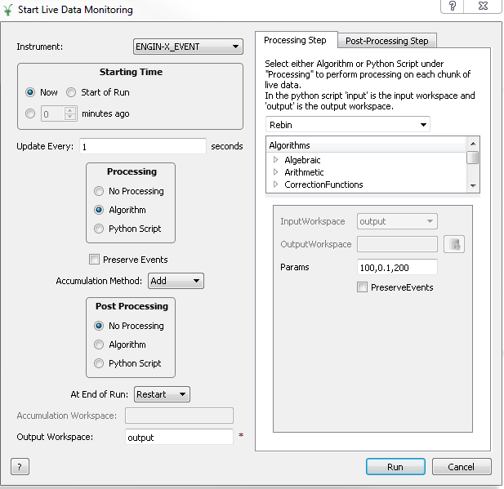
Monitoring live event data

Slide 20
Framework
Monitoring live event data:
Tested to handle up to 10 million events per second
Current restrictions:
Periodic data can be captured but not reduced on the fly
No handling of log data
To setup:
For now contact us

Slide 21
Python

Slide 22
Python
Release 3.0 (Nov)
v2 only works
v1 removed
Version 1 is dead, long live version 2!
IPython replaces old script interpreter
Limited set of algorithms defined as functions on workspaces:
.delete()
.rename()
.clone()
.convertUnits()
.rebin()
.maskDetectors()

Slide 23
Indirect Inelastic

Slide 24
Indirect Bayes
We have a new interface for the indirect group
Brings together existing Bayesian fitting workflow algorithms
ResNorm
Quasi (previously Qlines)
Stretch (previously Quest)
JumpFit
Similar to IDA…

Slide 25
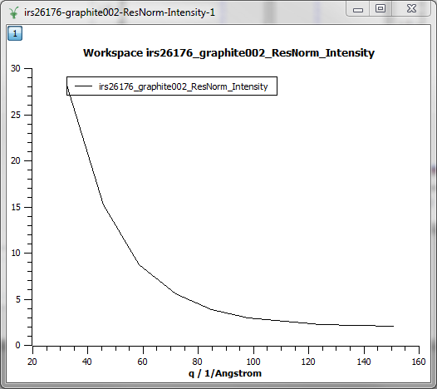
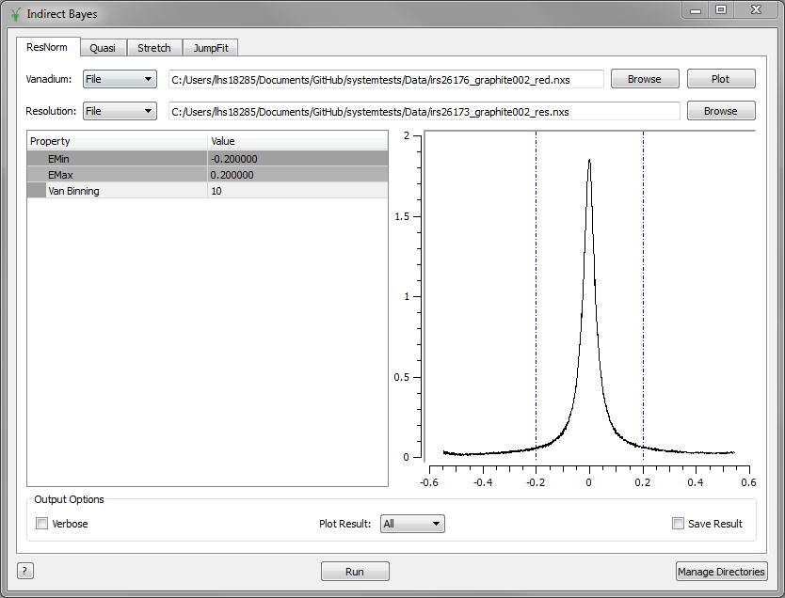
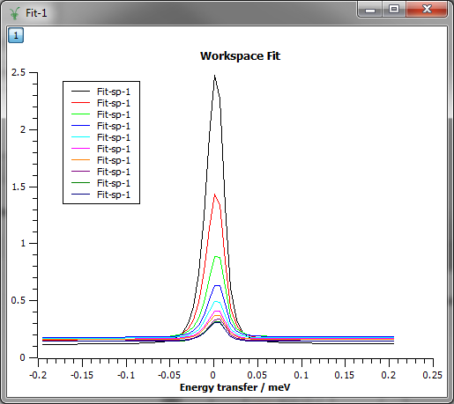
ResNorm

Slide 26
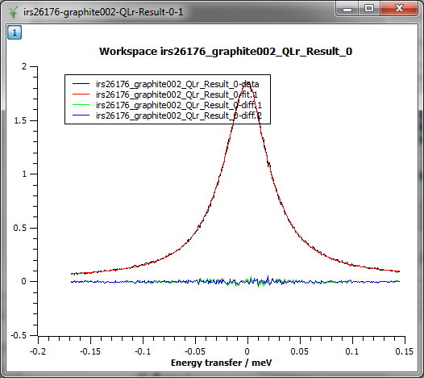
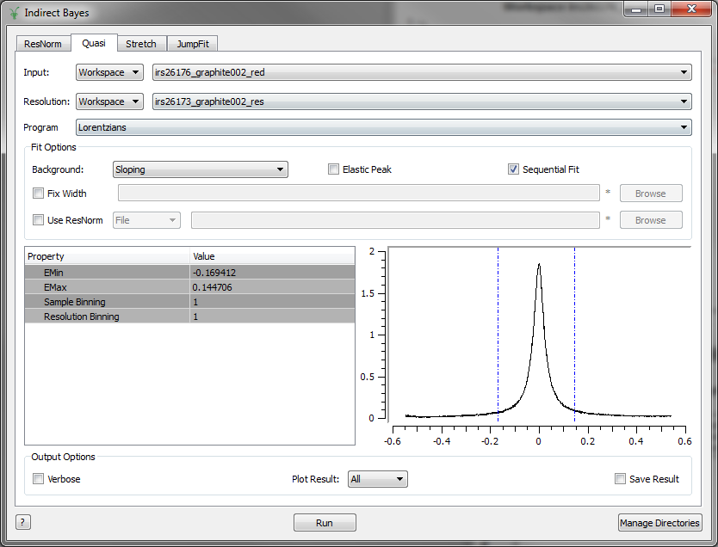
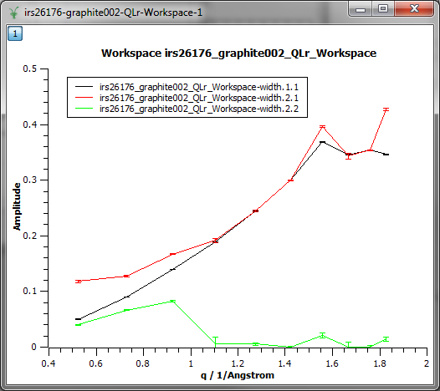
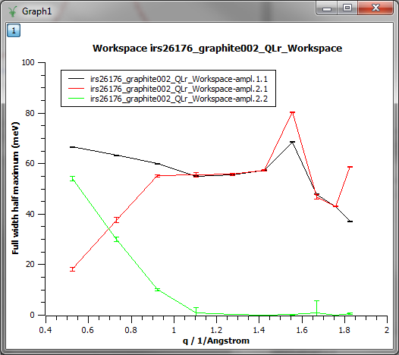
Quasi
Quasi replaces the Qlines workflow algorithm

Slide 27
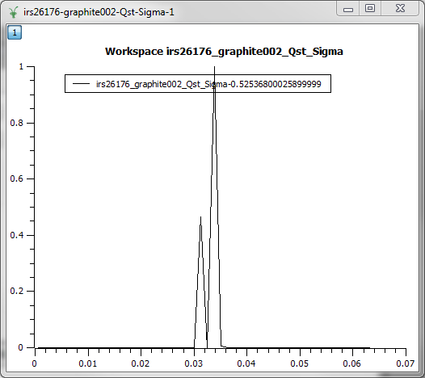
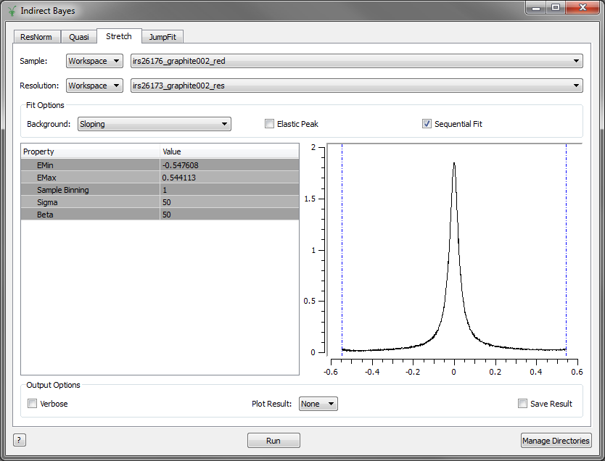
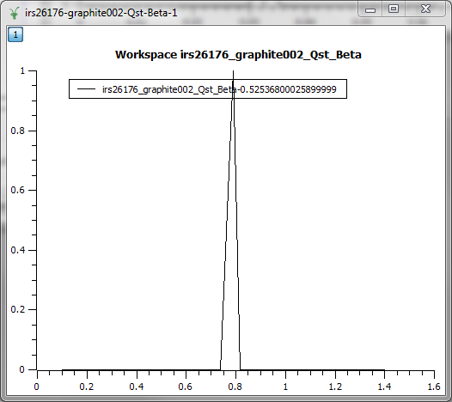
Stretch
Stretch replaces the Quest workflow algorithm

Slide 28
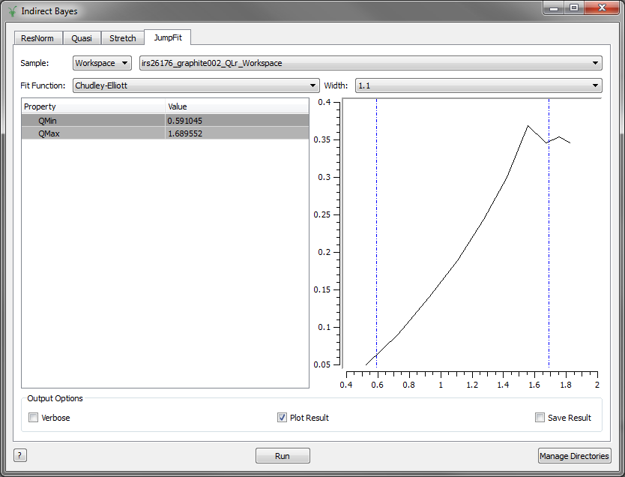
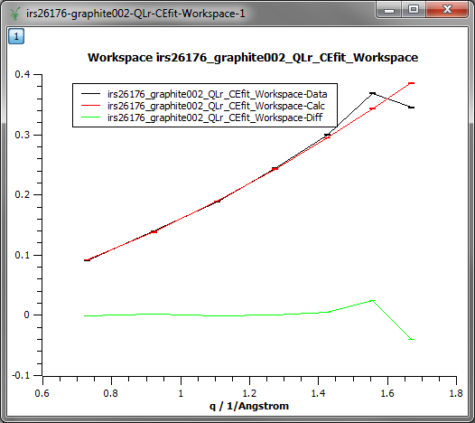
JumpFit
JumpFit replaces the corresponding workflow algorithm
Now just uses the Fit algorithm internally.

Slide 29
Demo

Slide 30
SANS

Slide 31

SANS
Extension of Fitting Transmission Options:

Slide 32
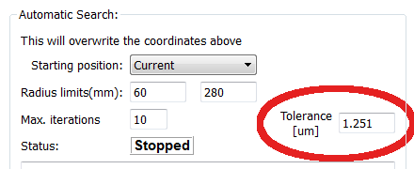
SANS
New parameter for searching centre

Slide 33
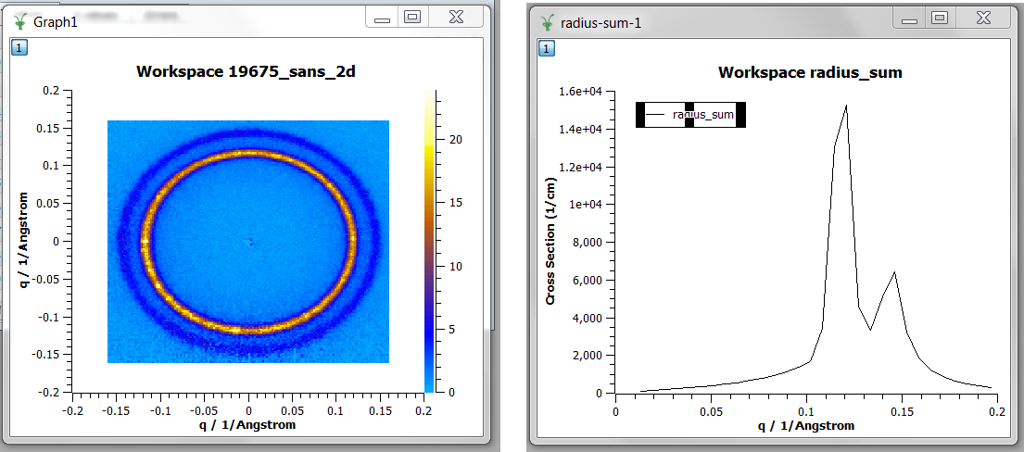
SANS
New Algorithm: RadiusSum

Slide 34
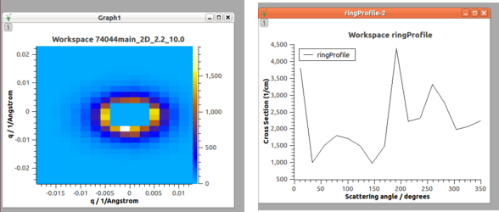
SANS
New Algorithm: RingProfile

Slide 35
Muon

Slide 36
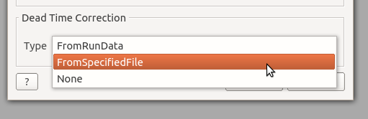
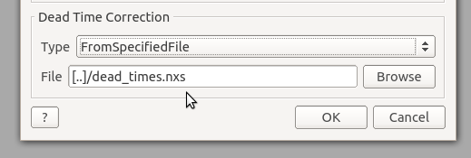
Muon
Dead Time Correction for PlotAsymmetryByLogValue

Slide 37
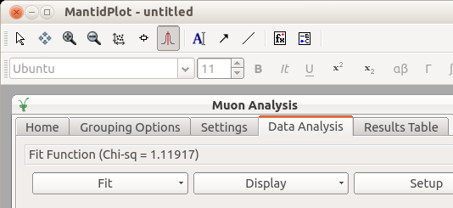
Muon
Graph Toolbar interaction with Muon Analysis

Slide 38
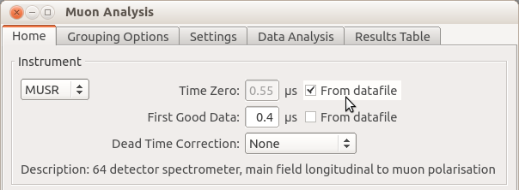
Muon
Time Zero and First Good Data values

Slide 39
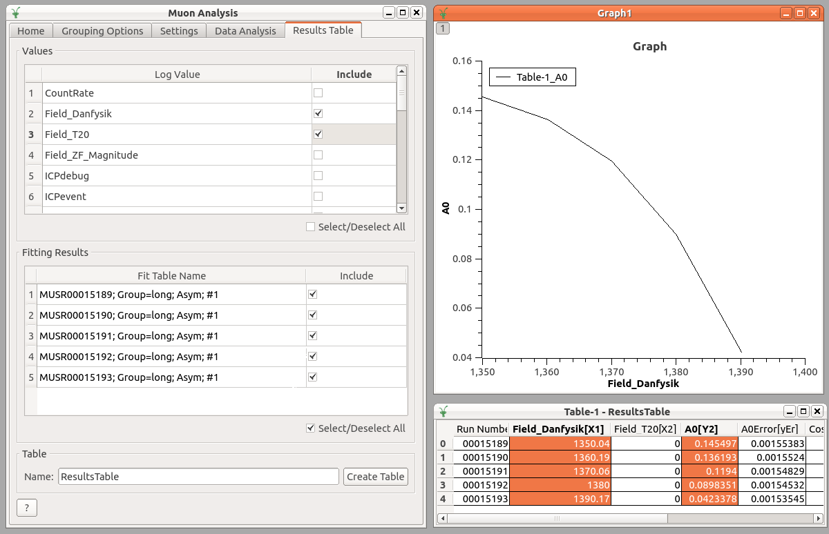
Muon
Plotting using selected log value as X

Slide 40
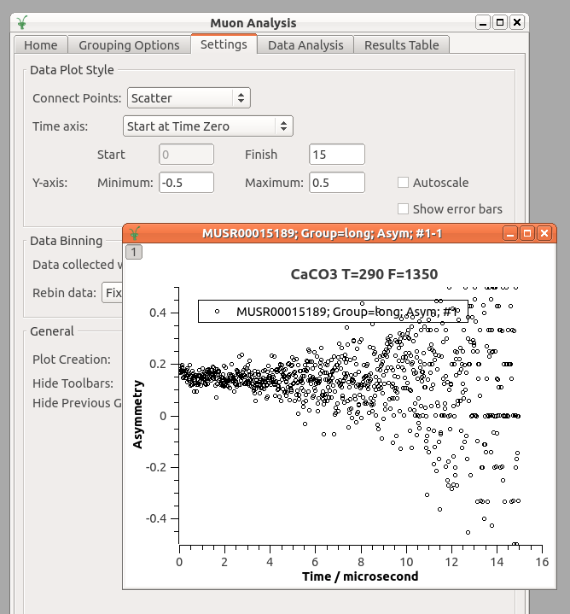
Muon
Instant plot style update

Slide 41
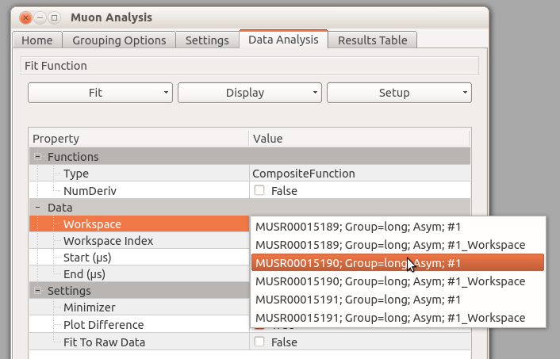
Muon
Quick fitted workspace switch

Slide 42
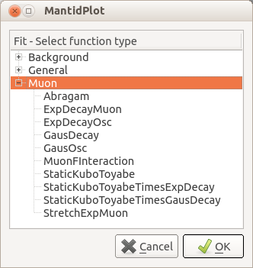
Muon
New fit functions

Slide 43
Muon
Minor UI improvements:
Automatic results table opening
Remembering user specified dead-time file
Remembering period algebra when switching runs
More fields auto-updating the plot
Human-readable date/time display
Under-the-hood:
Temporary grouping XML file removed
Use Python to interact with Mantid
Bugfixes

Slide 44
Reflectometry

Slide 45
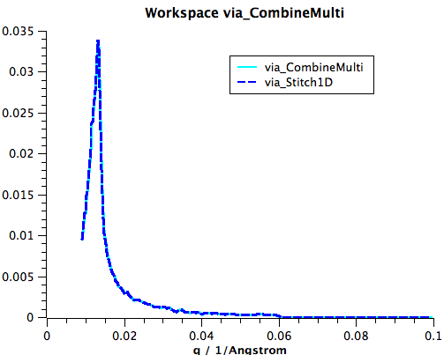
Reflectometry
Complete re-write of Stitch1D Algorithm
Identical results to combine2 python function
Algorithm has been tested and is being used at PSI
combineMulti script refurbished
Loops over Stitch1D (that’s all)
New Stitching Algorithm Stitch1DMany
Simpler inputs
Stricter input checking
Documented
Unit tested

Slide 46
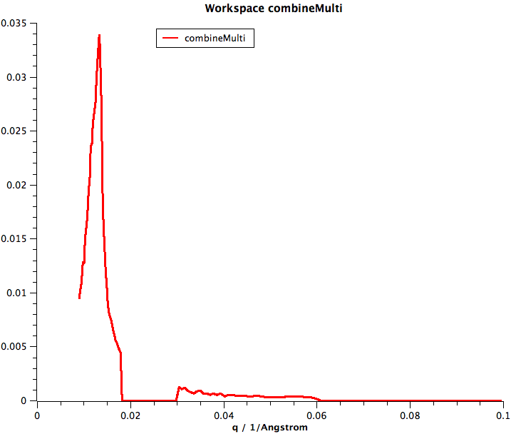
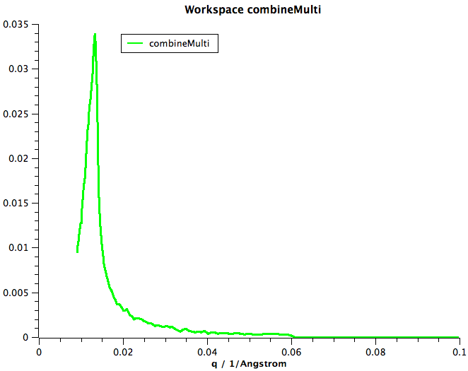
combineMulti issues fixed
Zeroed out here
Fixed

Slide 47

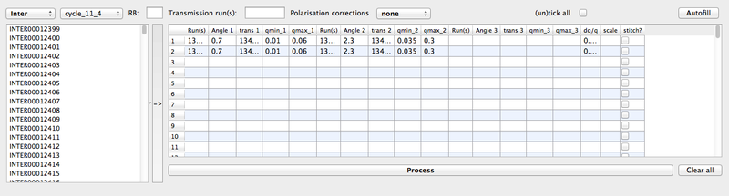

Gui Changes
Settings (Optional)
Mount point selection
Select data by instrument and cycle
No managed user directory changes
Help page link

Slide 48
Other Changes
New package location isis_reflectometry
import isis_reflectometry.quick as quick
import isis_reflectometry.combineMulti as combineMulti
New algorithm SortXAxis
Fixes plotting issues relating to sorting of x-axis data
Log10 option on LineViewer preview plot.

Slide 49
Diffraction

Slide 50
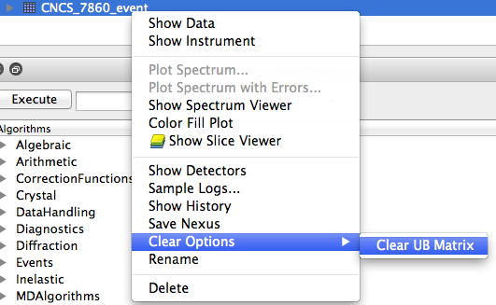
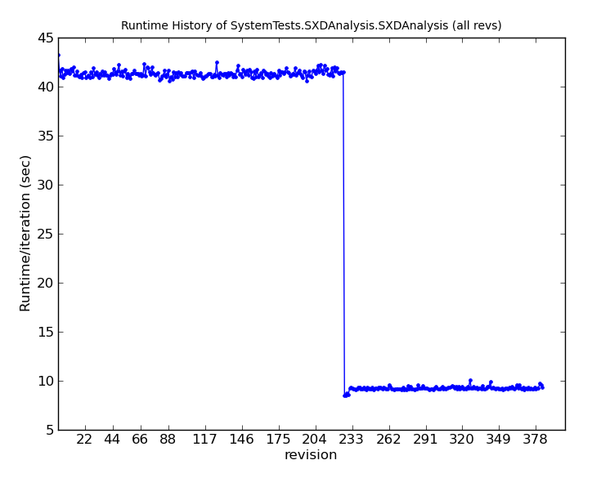
Algorithm Changes
New algorithm ClearUB
Right-click option
Major performance boost to ConvertToMD
Adaptable Q Radius for IntegratePeaksMD

Slide 51
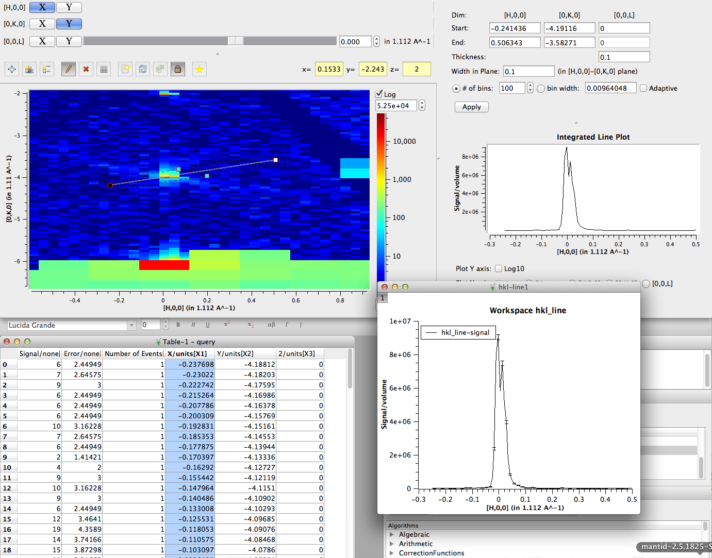
Exporting 1D Cuts
Fix to QueryMDWorkspace.

Slide 52

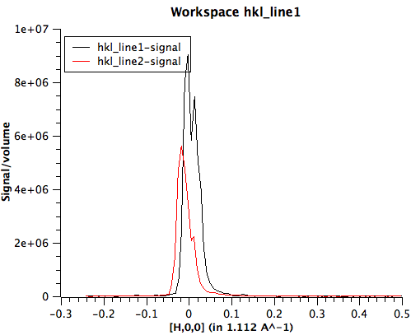
plotMD via python
plotMD is now exposed to python
- Allows optional normalization settings
- Allows multiple slices to be plotted simultaneously

Slide 53
Other Enhancements
Increased logging for SelectCellOfType and SelectCellWithForm
SCD workflow automatically copies back UB
New 9-Panel IDF for WISH

Slide 54
Next Release

Slide 55
What’s coming in v3.1
ISIS
Live event data reduction
Logs
Multi Period
Automatic Reduction
Expansion to more instruments
Upload to ICAT
Training courses
More sessions
ISIS & ORNL
Recording
ICAT 4 Multi facility support
Various technique led improvements

Slide 56

Thank you

